Slide 1



Tree Species Classification
AUTHOR : ANSHIKA PANDEY

Slide 2

Learning Objectives
Understand how to prepare image datasets for classification tasks.
Learn to build a tree species classifier using deep learning.
Apply CNNs to identify and categorize tree species from images.
Evaluate the performance of a trained classification model.
Gain hands-on experience with real-world environmental data.
GOAL
Source :
www.freepik.com/

Slide 3
Tools and Technology used
Python – Programming language for development
TensorFlow / Keras – For building and training CNN models
NumPy & Pandas – Data handling and manipulation
Matplotlib / Seaborn – Visualization of data and results
OpenCV / PIL – Image loading and preprocessing
Google Colab / Jupyter Notebook – Development environment
Git & GitHub – Code and dataset version control

Slide 4
Methodology-
Data Collection
Cloned image dataset from GitHub (TREESPECIES repo).
Images categorized into folders based on tree species.
Data Preprocessing
Loaded and labeled images.
Resized, normalized, and prepared images for training.
Model Building
Designed a Convolutional Neural Network (CNN) using TensorFlow/Keras.
Configured layers for feature extraction and classification.

Slide 5
Model Training
Trained the CNN model on labeled image data.
Applied techniques like data augmentation (if any).
Evaluation
Assessed model accuracy and loss on test/validation data.
Visualized performance using graphs (accuracy, loss).
Prediction & Deployment
Used the trained model to classify new tree species images.

Slide 6
Problem Statement:
Identifying tree species manually is time-consuming, error-prone, and requires expert knowledge. There is a need for an automated system that can accurately classify tree species using image data to support biodiversity conservation, forestry management, and environmental monitoring.

Slide 7
Solution:
Develop a deep learning-based image classification model using Convolutional Neural Networks (CNNs) that can automatically identify and classify tree species from images with high accuracy, reducing reliance on manual identification and enabling faster environmental assessments.

Slide 8
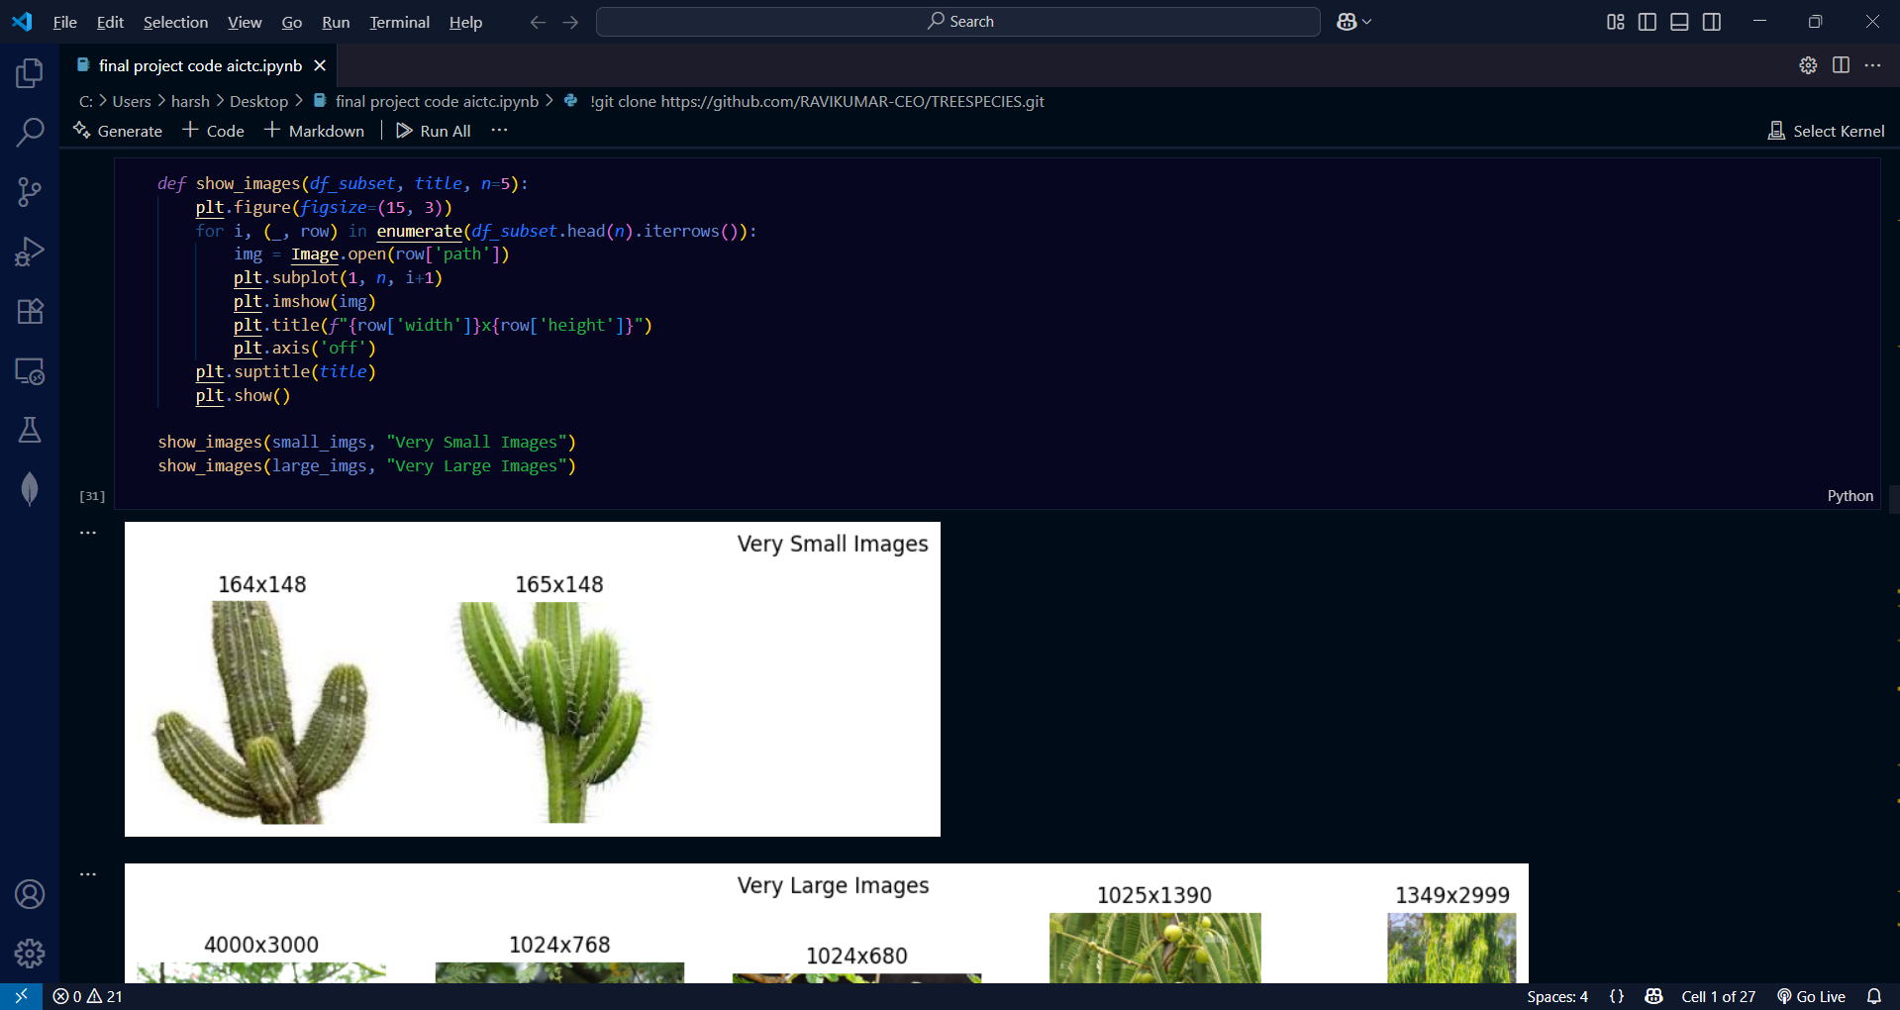
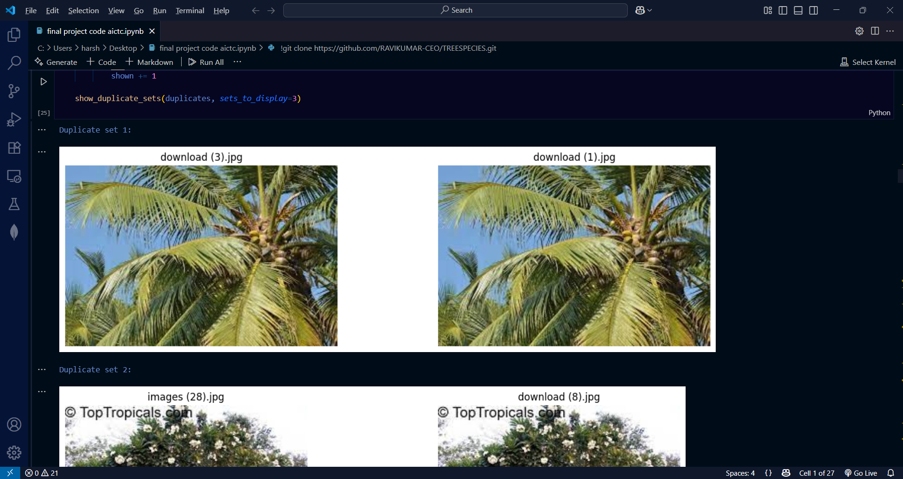
Screenshot of Output:

Slide 9

Screenshot of Output:

Slide 10
Conclusion:
The tree species classification model successfully demonstrates the potential of deep learning in automating environmental monitoring. By leveraging CNNs, the system accurately identifies tree species from images, offering a fast, reliable, and scalable solution that can aid researchers, conservationists, and forest managers.

Slide 11
Future Scope -
Expand Dataset – Include more tree species and seasonal variations.
Geo-Integration – Combine GPS data for location-based species suggestions.
Mobile App – Develop an easy-to-use field tool for researchers and citizens.
Advanced Models – Experiment with transformers and hybrid CNN architectures.
Continuous Learning – Enable model updates with new crowd-sourced data.

Slide 12
Real-World Applications-
Biodiversity Conservation – Monitor endangered tree species.
Forestry Management – Plan urban green cover and forest plantations.
Environmental Monitoring – Detect deforestation and disease outbreaks.
Education & Awareness – Help students and public identify tree species.
Smart City Initiatives – Integrate into environmental IoT systems.

